Slide 1


Slide 2
Leading with Strength
Applying Marine Core Leadership Traits to Software Development Teams

Slide 3
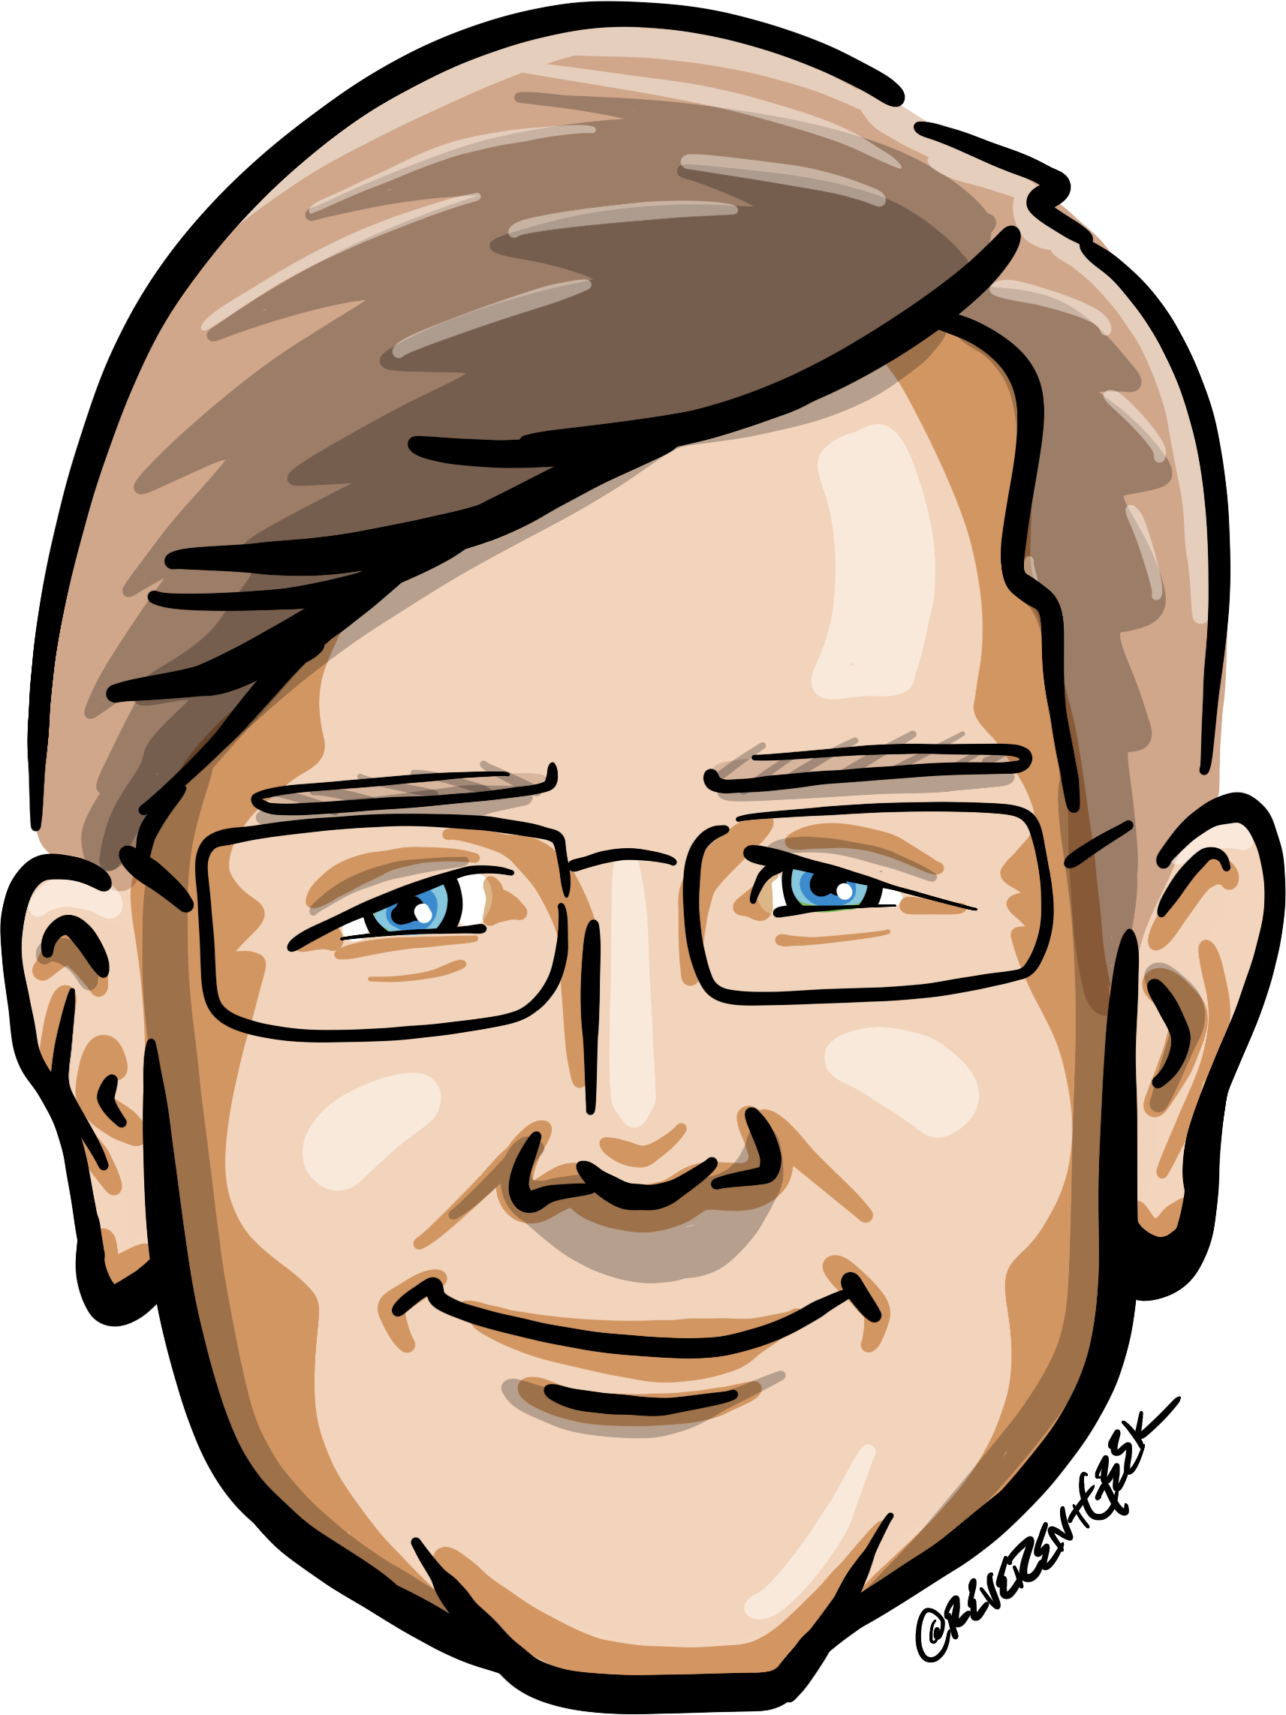






Who is Chad Green
Who is Chad Green
chadgreen@chadgreen.com
TaleLearnCode
ChadGreen.com
ChadGreen & TaleLearnCode
ChadwickEGreen

Slide 4

Who is Chad Green?
Director of Architecture at Aline
Previous Positions
Director of Software Development
Data & Solutions Architect
Service Delivery Manager
Product Delivery Manager
Project Manager
.NET Solution Architect
Developer
Community Involvement
Code PaLOUsa Conference Chair
Louisville .NET Meetup Organizer
Louisville Tech Leaders Meetup Organizer
Louisville Tech Ladies Co-Organizer
United States Marine Corps Veteran

Slide 5
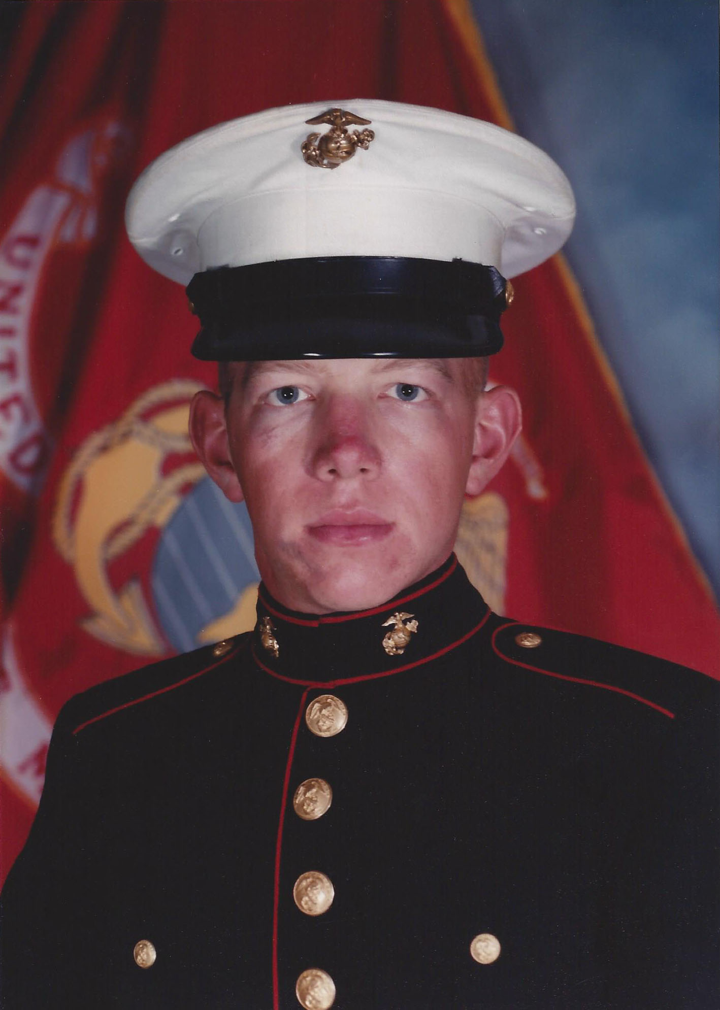
Who is Chad Green?
Director of Architecture at Aline
Previous Positions
Director of Software Development
Data & Solutions Architect
Service Delivery Manager
Product Delivery Manager
Project Manager
.NET Solution Architect
Developer
Community Involvement
Code PaLOUsa Conference Chair
Louisville .NET Meetup Organizer
Louisville Tech Leaders Meetup Organizer
Louisville Tech Ladies Co-Organizer
United States Marine Corps Veteran

Slide 6

Some people spend an entire lifetime wondering if they made a difference. The Marines don’t have that problem
Ronald Reagan

Slide 7
Leadership is more than leading
The power or ability to lead other people
The sum of those qualities of intellect, human understanding, and moral character that enables a person to inspire and control a group of people successfully

Slide 8


Slide 9
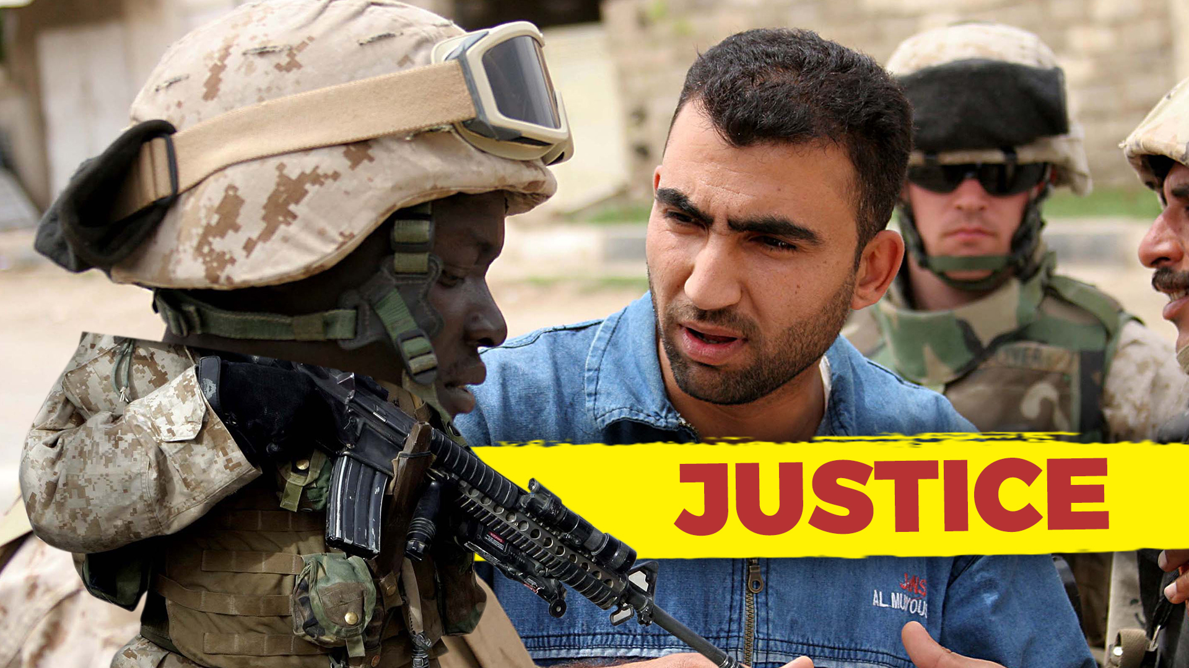
Notes:
Fair and Consistent – Be honest with yourself about decisions. Avoid favoritism. Treat all people, and things equally.
Be honest with yourself
Be aware of counter-productive prejudices
Listen to all sides of an issue
Avoid favoritism
Apply rewards and reprimands consistently
Be fair at all times
------
The "Justice" leadership trait from the US Marine Corps leadership principles emphasizes being fair and impartial in decision-making, ensuring that rewards and consequences are distributed equitably. While the context of the Marine Corps and software development teams are quite different, there are valuable lessons from the "Justice" trait that can be applied to leading a software development team effectively:
Fair Allocation of Work: Just as in the Marines where responsibilities are distributed fairly, a software development leader should ensure that tasks and projects are assigned based on team members' skills and workload capacity. Avoid favoritism or overburdening certain individuals.
Equal Opportunities: Uphold fairness by giving all team members the opportunity to contribute to important projects. Avoid excluding or favoring specific individuals based on personal biases, and consider diverse perspectives and ideas.
Merit-based Recognition: Recognize and reward team members based on their contributions and performance rather than personal preferences. Acknowledge achievements and efforts openly to promote a sense of fairness and motivation among the team.
Transparent Decision-Making: Communicate the reasoning behind decisions transparently, especially when it comes to resource allocation, project priorities, and performance evaluations. This helps in building trust and understanding among team members.
Accountability and Consequences: Just as in the Marine Corps where accountability is important, hold team members accountable for their actions and performance. Address poor performance or behavior consistently and fairly, applying appropriate consequences as necessary.
Equitable Workload: Ensure that the workload is distributed evenly among team members to prevent burnout and maintain a healthy work-life balance. Address any concerns or disparities promptly to maintain morale and productivity.
Inclusive Decision-Making: Involve the team in decision-making processes, allowing them to provide input and voice their concerns. This promotes a sense of ownership and fairness in team dynamics.
Unbiased Conflict Resolution: When conflicts arise, handle them impartially and ensure that all parties involved have an opportunity to share their perspective. Strive for solutions that are just and reasonable for all parties.
Personal Growth and Development: Support the growth of each team member by providing opportunities for learning, skill development, and career advancement. Avoid playing favorites and help all team members reach their full potential.
Ethical Considerations: Consider the ethical implications of decisions and actions within the software development process. Uphold ethical standards and avoid any unfair practices that could compromise the quality of the work or the well-being of team members.
Remember that while the leadership traits from the Marine Corps are adapted to the context of a software development team, the essence of fairness, integrity, and equity can contribute to creating a positive and effective leadership style in any environment.

Slide 10

Notes:
Good Judgement – Do not make rash decisions. Handle problems with a common sense attitude
Do not yield to impulse
Visualize the situation from another’s perspective
When in doubt, seek good counsel
Approach problems with common sense attitude
-----------------
The "Judgment" leadership trait from the US Marine Corps focuses on making informed and sound decisions, even in challenging and uncertain situations. Applying this trait to leading a software development team involves making thoughtful and strategic choices to guide the team towards success. Here's how you can apply the "Judgment" trait to lead a software development team effectively:
Gather Information: Before making decisions, gather all relevant information about the project, the team's capabilities, the technology landscape, and potential challenges. Understand the context to make informed choices.
Analyze Options: Consider multiple solutions or approaches to a problem. Evaluate the pros and cons of each option, taking into account technical feasibility, resource availability, and potential impact on the project.
Risk Assessment: Identify potential risks and uncertainties associated with different decisions. Assess the potential consequences and likelihood of each risk and devise strategies to mitigate them.
Involve the Team: Seek input from your team members. They often possess valuable insights and diverse perspectives that can contribute to better decision-making. Encourage open discussions and brainstorming sessions.
Balance Short-Term and Long-Term Goals: Consider both immediate project needs and the long-term goals of the software development team. Ensure that decisions align with the overall strategy and vision.
Decisiveness: While thorough analysis is important, timely decision-making is crucial in software development. Avoid getting caught in analysis paralysis and be prepared to make tough decisions when needed.
Adaptability: The software development landscape is dynamic and can change rapidly. Be prepared to adjust your decisions based on new information, changing requirements, or unexpected developments.
Account for Trade-offs: Understand that every decision involves trade-offs. Prioritize the most critical factors based on the situation, whether it's functionality, timeline, quality, or resources.
Consider Ethical Implications: Evaluate decisions from an ethical standpoint. Ensure that your choices align with ethical standards, both in terms of the technology being developed and the treatment of team members.
Communication: Clearly communicate your decisions and the rationale behind them to the team. This transparency fosters trust and helps team members understand the reasoning behind the chosen path.
Learn from Mistakes: Not every decision will lead to success. Embrace failures as learning opportunities. Analyze what went wrong, why it happened, and use these insights to make better decisions in the future.
Staying Calm Under Pressure: Just as Marines are trained to make decisions in high-pressure situations, software development leaders must stay composed when faced with tight deadlines, unexpected issues, or urgent decisions.
Continuous Learning: Stay updated on the latest technologies, industry trends, and best practices in software development. This knowledge equips you to make more informed decisions that align with the evolving landscape.
Applying the "Judgment" leadership trait involves a combination of analytical thinking, adaptability, communication, and a willingness to take calculated risks. By honing these skills, you can lead your software development team with confidence and guide them toward successful outcomes.

Slide 11

Notes:
Reliable – Be on time, avoid making excuses, and handle every task to be the best of your ability.
Being on time
Accomplishing your assigned tasks
Build a reputation for keeping your word
Demonstrating loyalty
Demonstrating loyalty
Speak positively about your leader
Speak only with those who have the authority to represent your concern
Build unity rather than a personal following
Avoid negative body language
Work hard and go the extra mile
Express gratitude for leader’s positive characteristics
------
The "Dependability" leadership trait from the US Marine Corps emphasizes reliability, accountability, and consistency. Applying this trait to leading a software development team involves creating a work environment where team members can rely on your leadership, trust your guidance, and feel confident in the team's ability to deliver quality results. Here's how you can apply the "Dependability" trait to lead a software development team effectively:
Clear Communication: Clearly communicate expectations, project goals, and individual responsibilities. Provide precise instructions and make sure everyone understands their roles and tasks.
Lead by Example: Demonstrate the behavior and work ethic you expect from your team. Model professionalism, dedication, and a strong work ethic to set the standard for reliability.
Consistency: Maintain a consistent leadership approach and decision-making process. Avoid sudden changes in direction that can lead to confusion and frustration among team members.
Reliable Planning: Develop well-thought-out project plans with realistic timelines and milestones. Consider potential challenges and allocate resources appropriately to ensure the team's success.
Accountability: Hold yourself and your team members accountable for meeting deadlines and delivering quality work. Address issues promptly and fairly when they arise.
Availability: Be accessible to your team for guidance, support, and problem-solving. Make an effort to address questions and concerns in a timely manner to keep projects on track.
Resource Management: Allocate resources efficiently, including both human resources and tools, to ensure that the team has what it needs to accomplish tasks effectively.
Problem Solving: When challenges arise, work collaboratively with your team to identify solutions. Use your experience to guide the team toward effective problem-solving strategies.
Transparency: Share relevant information about project status, changes, and challenges with your team. Transparent communication builds trust and fosters a sense of shared responsibility.
Adaptability: Be prepared to adapt to changing circumstances and requirements. Your ability to adjust plans while maintaining dependability sends a strong message to your team about your commitment.
Quality Focus: Prioritize delivering high-quality results. Avoid sacrificing quality for speed, and ensure that the team's work meets or exceeds established standards.
Support Professional Growth: Help your team members develop their skills and provide opportunities for learning. Invest in their growth to build a more capable and dependable team over time.
Recognition and Rewards: Acknowledge and celebrate achievements and milestones within the team. Recognizing hard work reinforces a culture of dependability and boosts morale.
Follow Through: Ensure that tasks and projects are completed as promised. Avoid making commitments that you cannot fulfill and ensure that your team follows through on their commitments as well.
Build Relationships: Cultivate strong relationships with team members based on trust, respect, and open communication. A dependable leader fosters a positive team atmosphere.
By embodying the "Dependability" trait, you can foster a reliable and productive software development team that consistently delivers quality results, meets deadlines, and works cohesively toward common goals.

Slide 12
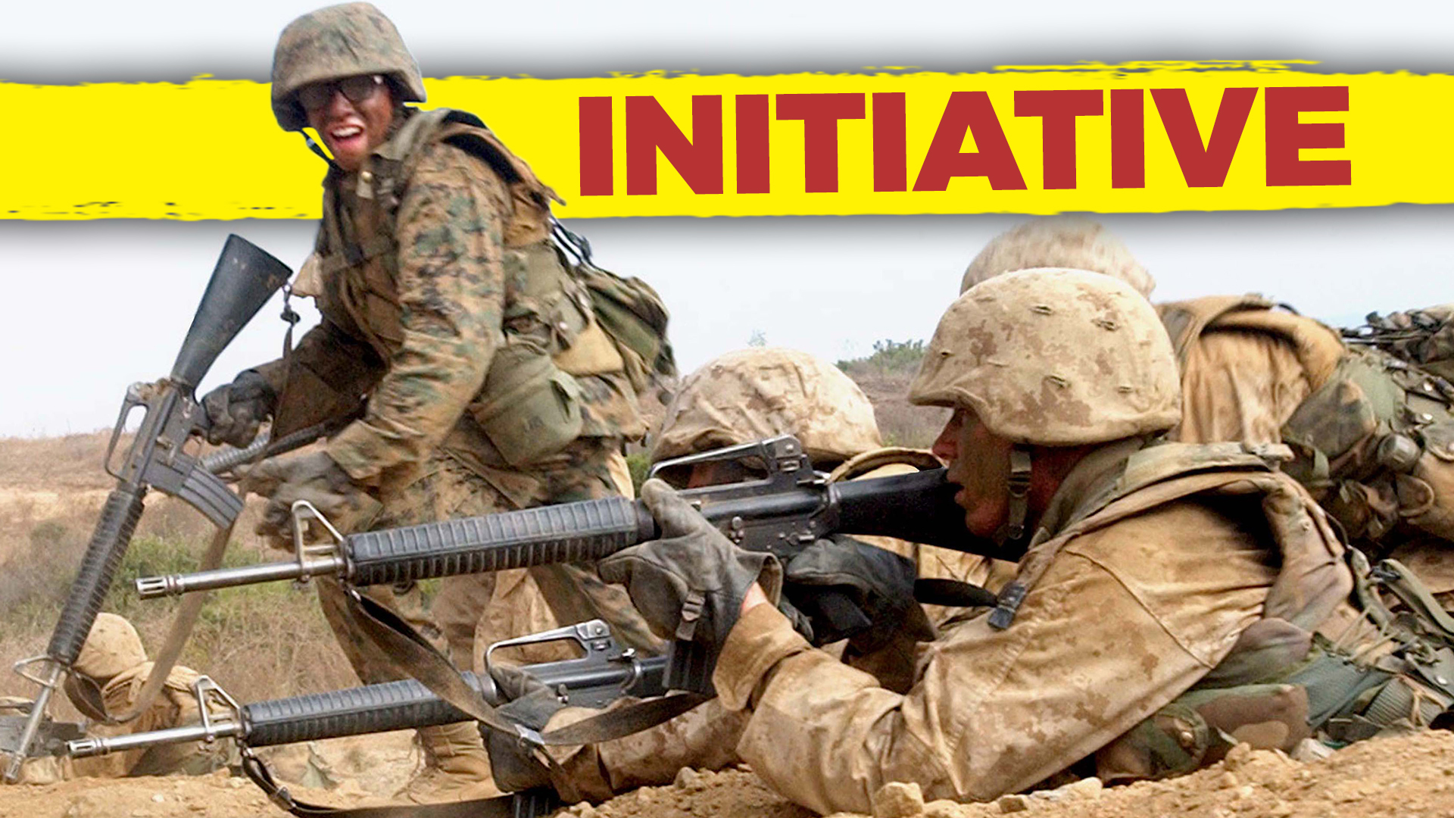
Notes:
Take initiative – Stay alert. Be aware of things that need to be done and then to do them without having to be told.
Be aware of things that need to be done and do them without being told
Look for better ways to do things
Work on staying mentally and physically alert
Look for better ways to do things
What would our customers what us to improve?
Who else could we help by using core competences?
What slows our work or makes it more difficult?
Work on staying mentally and physically alert
Healthy Diet
Drink Caffeine
Breathe Deeply
Go Outside
Stimulate the Mind
Play Music
-----
The "Initiative" leadership trait from the US Marine Corps involves taking action without being told, being proactive, and showing creativity in problem-solving. Applying this trait to leading a software development team entails fostering a culture of innovation, encouraging proactive thinking, and empowering team members to take ownership of their work. Here's how you can apply the "Initiative" trait to lead a software development team effectively:
Encourage Creative Thinking: Foster an environment where team members are encouraged to come up with new ideas and solutions. Welcome diverse perspectives and innovative approaches to problem-solving.
Empowerment: Delegate responsibilities and decision-making authority to team members. Give them the autonomy to take ownership of their tasks and initiatives, fostering a sense of empowerment.
Lead by Example: Demonstrate initiative in your own actions and decisions. Show your team that you're willing to go above and beyond, inspiring them to do the same.
Identify Opportunities: Continuously scan the software development landscape for new opportunities, emerging technologies, and market trends. Encourage your team to explore these opportunities and integrate them into projects.
Risk-Taking: Embrace calculated risks and encourage your team to do the same. Acknowledge that not every initiative will succeed, but failures can provide valuable learning experiences.
Problem-Solving Culture: Cultivate a culture where team members actively seek solutions to challenges. Encourage them to address problems proactively rather than waiting for issues to escalate.
Continuous Improvement: Promote the mindset of continuous improvement. Encourage team members to identify areas for enhancement and implement iterative changes to processes and products.
Innovation Time: Dedicate time for team members to work on personal projects or explore new ideas. This "innovation time" can lead to creative breakthroughs and novel solutions.
Open Communication: Create an open and inclusive communication environment where team members feel comfortable sharing their ideas and suggestions without fear of criticism.
Recognition of Initiative: Acknowledge and celebrate team members who take initiative and contribute innovative ideas. Recognize their efforts to inspire others to follow suit.
Align with Goals: Ensure that initiatives align with the team's goals and the overall business objectives. Initiatives should contribute to the team's mission and strategic direction.
Provide Resources and Support: Offer the necessary resources, tools, and training to support team members' initiatives. Remove obstacles that may hinder their progress.
Learn from Failure: Emphasize that failure is a part of the learning process. Encourage team members to analyze failures, extract lessons, and apply those lessons to future initiatives.
Document Best Practices: Encourage team members to document successful initiatives and best practices. This knowledge-sharing promotes a culture of learning and growth.
Collaboration: Encourage cross-functional collaboration and idea sharing. Often, innovative solutions emerge from diverse perspectives and skill sets.
By embracing the "Initiative" trait, you can create a dynamic and innovative software development team that proactively seeks solutions, explores new opportunities, and drives continuous improvement. This proactive approach can lead to increased creativity, efficiency, and overall success for your team and projects.

Slide 13

Notes:
Good decisions without delay – Be positive in your actions. Act with conviction and avoid changing directions on an issue.
Consider several points of view; then make best choice
Know when not to make a decision
Good decision now is better than perfect decision later
Be positive in your actions
-------------
The "Decisiveness" leadership trait from the US Marine Corps involves making timely and effective decisions, even in high-pressure situations. Applying this trait to leading a software development team involves making well-informed choices that guide the team toward successful outcomes. Here's how you can apply the "Decisiveness" trait to lead a software development team effectively:
Clear Vision: Establish a clear vision for the project and the team's goals. This clarity will provide a foundation for making decisions that align with the larger objectives.
Gather Information: Collect relevant information and data before making decisions. Consider the technical aspects, project requirements, constraints, and potential risks.
Prioritize: Assess the urgency and impact of different decisions. Prioritize tasks and choices based on their significance to the project's success.
Rapid Response: In time-sensitive situations, demonstrate the ability to make quick decisions. Balance speed with thorough consideration to avoid hasty choices.
Analysis-Action Balance: Find a balance between analysis and action. While thorough analysis is important, avoid getting stuck in endless deliberation.
Consultation: Seek input from team members and experts when necessary. Collaborative decision-making can lead to more well-rounded and effective choices.
Accountability: Take responsibility for your decisions, whether they lead to success or setbacks. Acknowledge when mistakes are made and work towards solutions.
Risk Management: Embrace calculated risks and understand that not all decisions will guarantee success. Assess potential risks and develop contingency plans.
Long-Term Impact: Consider the long-term implications of your decisions on the project, the team, and the organization. Strive for choices that contribute to sustained success.
Adaptability: Be open to adjusting decisions if new information arises or circumstances change. Adaptability is crucial in the dynamic field of software development.
Communication: Communicate decisions clearly and transparently to the team. Explain the rationale behind your choices to foster understanding and buy-in.
Consistency: Establish a consistent decision-making framework. This builds trust among team members and helps them predict how decisions will be made.
Decisive Confidence: Demonstrate confidence in your decisions, even when faced with uncertainty. Your confidence can inspire trust and stability within the team.
Conflict Resolution: Address conflicts and disagreements decisively, aiming for resolutions that benefit the project and maintain team cohesion.
Feedback Loop: Implement a feedback loop to evaluate the outcomes of decisions. Use this information to learn and improve your decision-making process over time.
By embodying the "Decisiveness" trait, you'll lead your software development team with clarity and confidence. Making timely and well-considered decisions will guide your team toward achieving project milestones, handling challenges, and contributing to the overall success of the team's endeavors.

Slide 14

Notes:
Maintain good relations – Be courteous and cheerful at all times. Treat others as you would like to be treated.
Be courteous and cheerful at all times
Check yourself for tolerance and patience
Apply the Gold Rule
Apply the Gold Rule
Practice empathy
Practice compassion
How would you want to be treated?
Be friendly
Be helpful
Listen to others
Overcome prejudice
Stop criticism
Do not control others
Be the change
--------
The "Tact" leadership trait from the US Marine Corps involves treating others with respect and sensitivity, even in difficult situations. Applying this trait to leading a software development team involves effective communication, fostering a positive work environment, and addressing challenges with empathy and understanding. Here's how you can apply the "Tact" trait to lead a software development team effectively:
Respectful Communication: Communicate with team members in a respectful and considerate manner. Use positive language and avoid confrontational or aggressive behavior.
Active Listening: Practice active listening to understand your team members' concerns, ideas, and feedback. This demonstrates your genuine interest in their perspectives.
Empathy: Put yourself in your team members' shoes to understand their experiences, challenges, and viewpoints. Show empathy when addressing their needs and concerns.
Constructive Feedback: Provide feedback that is both constructive and encouraging. Offer specific examples and suggestions for improvement, while also acknowledging their strengths.
Conflict Resolution: Address conflicts and disagreements diplomatically. Encourage open dialogue and find common ground to resolve issues without escalating tensions.
Cultural Sensitivity: Be mindful of cultural differences and diverse backgrounds within your team. Respect different viewpoints and adapt your communication style accordingly.
Praise and Recognition: Recognize and appreciate your team's efforts and achievements. Celebrate successes and acknowledge individual contributions in a tactful manner.
Balancing Critique: When offering critiques or pointing out areas for improvement, do so in a way that focuses on growth and development rather than belittling or demoralizing.
Transparency: Be open and transparent in your communication, sharing relevant information with your team members. This fosters trust and reduces uncertainty.
Privacy and Confidentiality: Respect team members' privacy and maintain confidentiality when handling sensitive matters, such as personal issues or sensitive project information.
Personalized Leadership: Understand that each team member has unique needs and preferences. Tailor your leadership approach to accommodate individual differences.
Mediation Skills: If conflicts arise among team members, act as a mediator to facilitate productive discussions and find mutually acceptable solutions.
Considerate Decision-Making: When making decisions, consider the potential impact on team members. Strive for choices that are fair and that take into account their well-being.
Encourage Collaboration: Promote collaboration and teamwork by fostering an environment where team members feel comfortable sharing ideas and working together.
Feedback Channels: Provide avenues for team members to share their thoughts, concerns, and suggestions. Regularly seek feedback to demonstrate your commitment to their input.
Applying the "Tact" trait can create a positive and inclusive atmosphere within your software development team. By treating your team members with respect, empathy, and sensitivity, you'll foster strong working relationships, enhance communication, and contribute to a more productive and harmonious work environment.

Slide 15

Notes:
Honest and truthful – Be honest and truthful at all times. Have a backbone, stand up for what you believe is right.
Be absolute honest and truthful at all times
Stand up for what you believe to be right
---------------------------
The "Tact" leadership trait from the US Marine Corps involves treating others with respect and sensitivity, even in difficult situations. Applying this trait to leading a software development team involves effective communication, fostering a positive work environment, and addressing challenges with empathy and understanding. Here's how you can apply the "Tact" trait to lead a software development team effectively:
Respectful Communication: Communicate with team members in a respectful and considerate manner. Use positive language and avoid confrontational or aggressive behavior.
Active Listening: Practice active listening to understand your team members' concerns, ideas, and feedback. This demonstrates your genuine interest in their perspectives.
Empathy: Put yourself in your team members' shoes to understand their experiences, challenges, and viewpoints. Show empathy when addressing their needs and concerns.
Constructive Feedback: Provide feedback that is both constructive and encouraging. Offer specific examples and suggestions for improvement, while also acknowledging their strengths.
Conflict Resolution: Address conflicts and disagreements diplomatically. Encourage open dialogue and find common ground to resolve issues without escalating tensions.
Cultural Sensitivity: Be mindful of cultural differences and diverse backgrounds within your team. Respect different viewpoints and adapt your communication style accordingly.
Praise and Recognition: Recognize and appreciate your team's efforts and achievements. Celebrate successes and acknowledge individual contributions in a tactful manner.
Balancing Critique: When offering critiques or pointing out areas for improvement, do so in a way that focuses on growth and development rather than belittling or demoralizing.
Transparency: Be open and transparent in your communication, sharing relevant information with your team members. This fosters trust and reduces uncertainty.
Privacy and Confidentiality: Respect team members' privacy and maintain confidentiality when handling sensitive matters, such as personal issues or sensitive project information.
Personalized Leadership: Understand that each team member has unique needs and preferences. Tailor your leadership approach to accommodate individual differences.
Mediation Skills: If conflicts arise among team members, act as a mediator to facilitate productive discussions and find mutually acceptable solutions.
Considerate Decision-Making: When making decisions, consider the potential impact on team members. Strive for choices that are fair and that take into account their well-being.
Encourage Collaboration: Promote collaboration and teamwork by fostering an environment where team members feel comfortable sharing ideas and working together.
Feedback Channels: Provide avenues for team members to share their thoughts, concerns, and suggestions. Regularly seek feedback to demonstrate your commitment to their input.
Applying the "Tact" trait can create a positive and inclusive atmosphere within your software development team. By treating your team members with respect, empathy, and sensitivity, you'll foster strong working relationships, enhance communication, and contribute to a more productive and harmonious work environment.

Slide 16

Notes:
Interested and exuberant – You are enthusiastic, optimistic, cheerful, and willing to accept challenges.
Consistently exhibit a positive attitude to others
Emphasize your subordinates’ success
Encourage others to overcome any obstacles which they encounter
------
The "Enthusiasm" leadership trait from the US Marine Corps involves showing genuine passion, energy, and positive attitude. Applying this trait to leading a software development team involves inspiring motivation, fostering a vibrant work environment, and encouraging creativity. Here's how you can apply the "Enthusiasm" trait to lead a software development team effectively:
Passion for Technology: Exhibit genuine excitement for technology and software development. Share your enthusiasm for the field to inspire your team's interest and motivation.
Positive Attitude: Maintain a positive and optimistic outlook, even in the face of challenges. Your attitude can influence the team's morale and overall work atmosphere.
Inspire Creativity: Encourage innovative thinking and creative problem-solving. Your enthusiasm for new ideas can stimulate your team to explore novel solutions.
Celebration of Achievements: Celebrate successes, whether they're small milestones or major accomplishments. Recognize and appreciate your team's hard work and contributions.
Motivate and Energize: Infuse energy into the team by setting an enthusiastic tone during meetings, discussions, and interactions. Your enthusiasm can be contagious.
Open Communication: Maintain open channels of communication with your team. Regularly share updates, insights, and progress reports to keep everyone engaged and informed.
Personal Investment: Show that you're invested in the team's growth and success. Offer your time, guidance, and resources to support their professional development.
Lead by Example: Demonstrate your dedication and commitment to the team's goals through your own actions. Show that you're willing to go the extra mile.
Learning Culture: Foster a culture of continuous learning and improvement. Encourage your team to explore new technologies, trends, and skills to stay motivated and relevant.
Listening to Ideas: Be receptive to your team's ideas and suggestions. Show genuine interest in their input and incorporate their perspectives into decision-making.
Energetic Meetings: Conduct meetings with energy and enthusiasm. Use these opportunities to inspire discussions, share updates, and boost team morale.
Flexibility and Adaptability: Adapt your leadership style to match the team's needs and preferences. Being flexible in your approach can foster a more engaged and motivated team.
Public Recognition: Publicly acknowledge team members' contributions and efforts. Highlight their achievements in team meetings or within the organization.
Feedback and Growth: Provide constructive feedback in a supportive and encouraging manner. Help your team members identify areas for improvement and growth.
Maintain Momentum: Sustain your enthusiasm throughout the project lifecycle. Consistent enthusiasm can help keep motivation high even during challenging phases.
By embodying the "Enthusiasm" trait, you can create a software development team that is motivated, inspired, and excited about their work. Your positive attitude and passion can contribute to a vibrant work culture, increased creativity, and a greater sense of camaraderie among team members.

Slide 17
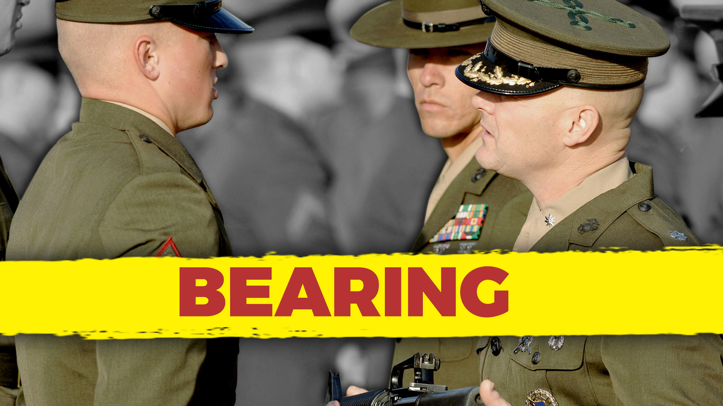
Notes:
Competent, confident, and in-control – Reach for the top standards of conduct. Just getting by is unacceptable.
Hold yourself to the highest standards of personal conduct
Control your voice and gestures
Avoid reprimanding in the presence of others
Avoid profanity or vulgarity
------------------------
The "Bearing" leadership trait from the US Marine Corps involves projecting confidence, composure, and a professional demeanor. Applying this trait to leading a software development team involves maintaining a strong and composed presence, demonstrating professionalism, and effectively managing emotions in various situations. Here's how you can apply the "Bearing" trait to lead a software development team effectively:
Confident Presence: Project confidence in your decisions and actions. Your demeanor can inspire trust and create a sense of stability within the team.
Professionalism: Set high standards for professionalism in both your behavior and your team's conduct. Uphold a respectful and ethical work environment.
Calm under Pressure: Maintain composure, especially during challenging situations or tight deadlines. Your ability to stay calm can positively influence the team's response.
Effective Communication: Communicate clearly and effectively, especially when conveying complex information or addressing sensitive topics. Your communication style sets the tone for the team's interactions.
Decisiveness: Make decisions confidently, even in uncertain circumstances. Your decisiveness can provide clarity and direction for the team.
Poise in Conflict: Handle conflicts and disagreements with poise and professionalism. Encourage productive discussions while preventing situations from escalating.
Empathy and Understanding: Show empathy and understanding towards team members' concerns, emotions, and challenges. Your balanced approach can foster a supportive atmosphere.
Modeling Behavior: Set an example for the team by demonstrating the behavior, work ethic, and attitude you expect from them. Lead by showing, not just telling.
Grace under Criticism: Receive feedback and criticism with grace and an open mind. Your ability to accept constructive input sets a positive tone for feedback exchanges.
Consistency: Maintain a consistent approach to leadership. A steady and reliable presence helps the team feel secure and supported.
Prioritization: Prioritize tasks and projects confidently based on their importance and impact. Your clear priorities guide the team's efforts.
Professional Development: Invest in your own professional development to enhance your knowledge and skills. This commitment sets an example for continuous growth.
Handling Ambiguity: Deal with ambiguity and uncertainty with a composed and adaptable attitude. Your ability to navigate through uncertain situations can reassure the team.
Ethical Standards: Uphold strong ethical standards in your decision-making and actions. Model integrity and ethical behavior for the team.
Conflict Resolution: Address conflicts and challenges with a calm and balanced approach. Seek resolutions that align with the team's goals and well-being.
By embodying the "Bearing" trait, you can create a work environment characterized by professionalism, composure, and a sense of security. Your confident and composed leadership style can positively impact the software development team's morale, performance, and overall effectiveness.

Slide 18

Notes:
Considerate – You give credit to those who deserve it and avoid using your authority for personal gain at the expense of others.
Give credit for job well done
Help your subordinates with the mundane tasks
Avoid using your position for personal gain, safety, or pleasure
-------------------
The "Unselfishness" leadership trait from the US Marine Corps involves putting the needs of the team and the mission ahead of personal desires. Applying this trait to leading a software development team involves prioritizing the well-being and growth of your team members, fostering collaboration, and focusing on the team's collective success. Here's how you can apply the "Unselfishness" trait to lead a software development team effectively:
Support Team Growth: Invest in the professional development of your team members. Provide opportunities for learning, training, and skill enhancement to help them grow in their roles.
Empowerment: Delegate responsibilities and decision-making to team members, allowing them to take ownership of their work and contribute meaningfully to the team's success.
Share Credit: Acknowledge and give credit to your team members for their achievements and contributions. Highlight their individual and collective efforts.
Open Collaboration: Encourage a culture of open collaboration and knowledge sharing. Foster an environment where team members freely exchange ideas and support one another.
Prioritize Team Needs: Consider the needs of the team when making decisions. Strive for choices that benefit the team's well-being and long-term growth.
Selfless Service: Lead by example by demonstrating a willingness to take on tasks that benefit the team, even if they fall outside your primary responsibilities.
Coaching and Mentorship: Offer guidance, coaching, and mentorship to team members to help them reach their full potential. Help them overcome challenges and develop new skills.
Listen to Concerns: Be receptive to your team members' concerns, feedback, and suggestions. Address their needs and advocate for their interests.
Resource Allocation: Allocate resources equitably, ensuring that each team member has the tools, support, and opportunities they need to succeed.
Team Goals Over Personal Goals: Prioritize the team's goals and success over personal agendas. Make decisions that align with the collective mission rather than personal gain.
Servant Leadership: Embrace a servant leadership approach, where your focus is on serving the needs of the team and helping them achieve their objectives.
Embrace Diverse Perspectives: Encourage team members to share their unique viewpoints and perspectives. Embrace diversity of thought and experience to drive innovation.
Conflict Resolution: Handle conflicts and disagreements with the team's best interests in mind. Seek resolutions that promote unity and collaboration.
Promote a Positive Culture: Foster a positive and inclusive work culture where team members feel valued and supported, enabling them to contribute their best.
Balancing Workload: Distribute tasks and responsibilities fairly, taking into account each team member's strengths, workload capacity, and growth goals.
By embodying the "Unselfishness" trait, you can create a collaborative and supportive environment within your software development team. Putting the team's needs first, prioritizing their growth, and promoting a sense of collective achievement can lead to higher morale, increased engagement, and ultimately, greater success for the entire team.

Slide 19

Notes:
Remain calm while facing fear – Practice self-discipline and calmness. Force yourself to control your reaction to fear.
Look for and willingly accept responsibilities
Never blame others for your mistakes
Place duty and commitment to mission over personal feelings
------------------------
The "Courage" leadership trait from the US Marine Corps involves facing challenges and making tough decisions even in the face of adversity. Applying this trait to leading a software development team involves demonstrating resilience, taking calculated risks, and standing up for what is right. Here's how you can apply the "Courage" trait to lead a software development team effectively:
Embrace Innovation: Encourage your team to explore innovative ideas and technologies. Embrace the uncertainty that comes with trying new approaches to software development.
Risk Management: Analyze risks associated with project decisions, but don't shy away from necessary risks that can lead to greater rewards. Make informed decisions that balance potential benefits and drawbacks.
Stand Up for Values: Uphold ethical standards and ensure that the software being developed aligns with ethical guidelines. Be willing to challenge decisions that compromise your team's integrity.
Difficult Conversations: Address conflicts, performance issues, and sensitive topics with courage and professionalism. Approach difficult conversations in a constructive and empathetic manner.
Adaptability: Be open to change and willing to adapt your strategies as circumstances evolve. Display the courage to pivot when necessary to achieve better results.
Champion New Ideas: Advocate for your team's ideas and proposals, even if they challenge the status quo. Stand up for initiatives that have the potential to drive positive change.
Accountability: Take responsibility for both successes and failures. Acknowledge your role in decision-making and outcomes, showing that you're willing to learn from experiences.
Speak Up: Be willing to voice your opinions and concerns, even if they go against popular viewpoints. Constructively express your thoughts to contribute to meaningful discussions.
Moral Courage: Stand up for what is right, even when it's difficult or unpopular. Advocate for fairness, diversity, inclusion, and ethical behavior within your team.
Balancing Stakeholder Interests: Navigate competing interests from stakeholders while making decisions that prioritize the long-term success of the project and the well-being of your team.
Resilience: Stay strong and composed in the face of setbacks, failures, or challenges. Show your team that setbacks are opportunities for growth and learning.
Inclusive Leadership: Have the courage to actively seek out diverse perspectives and create an inclusive environment that welcomes different voices.
Transparency: Communicate openly about project challenges, setbacks, and uncertainties. Your willingness to share difficult information fosters trust and transparency.
Supporting Your Team: Be an advocate for your team, providing them with the resources and support they need to overcome obstacles and achieve their goals.
Lead with Conviction: Lead your team with unwavering conviction in your decisions and strategies. Display confidence that inspires trust and commitment from your team members.
By embodying the "Courage" trait, you can create a software development team that is willing to take calculated risks, face challenges head-on, and uphold ethical principles. Your courage will inspire your team to approach their work with determination, resilience, and a commitment to achieving excellence.

Slide 20
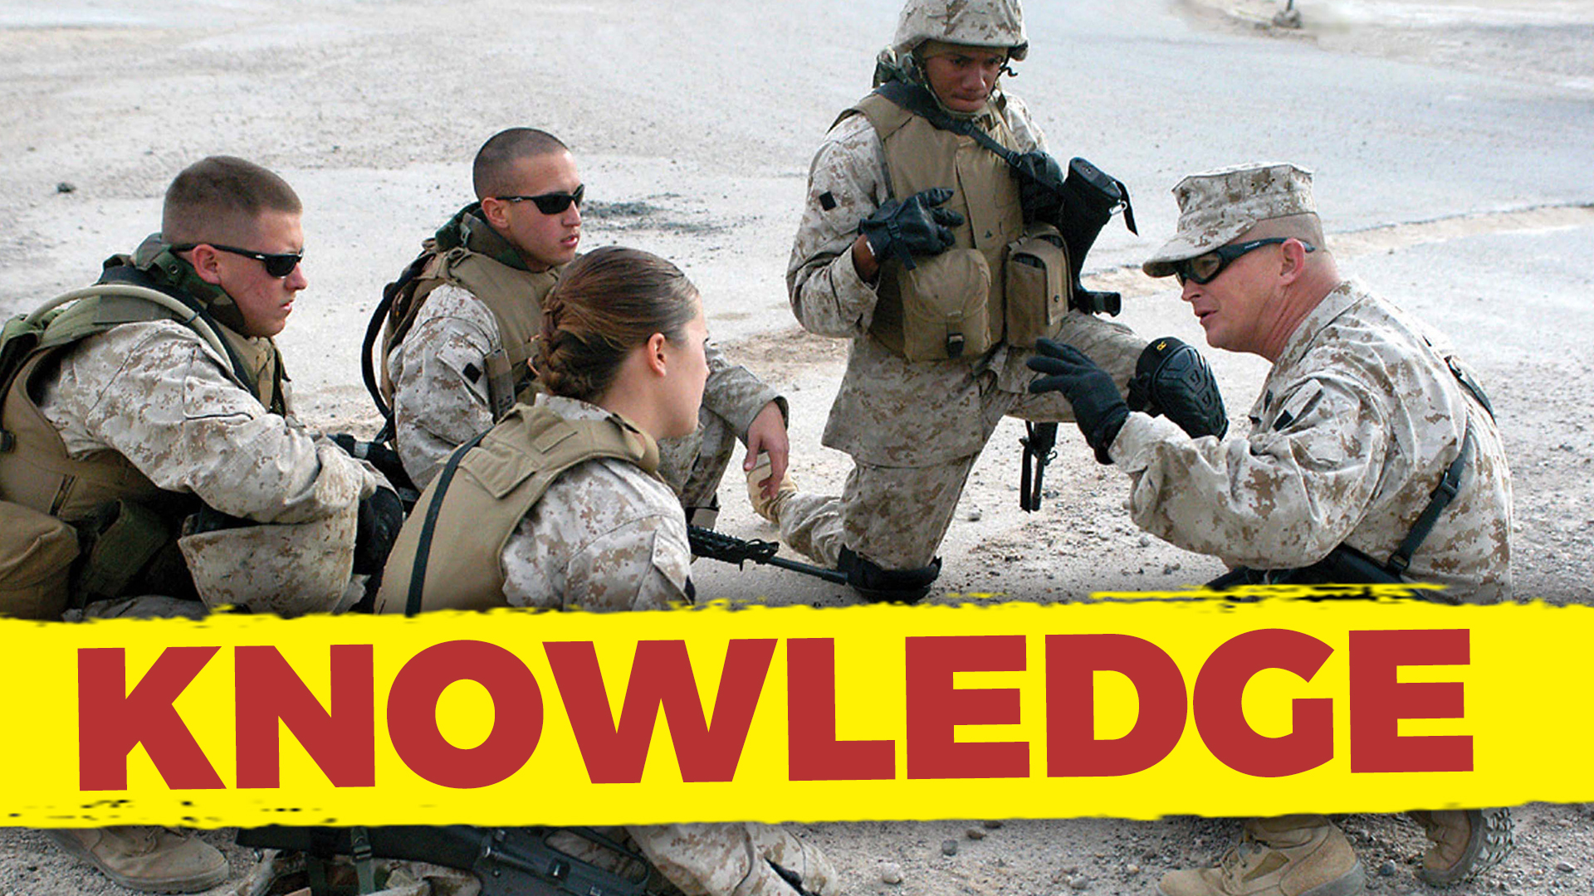
Notes:
Knowledgeable – Remain alert. Listen, observe, and find out about things you don’t get. Study and stay current!
Increase your knowledge by remaining alert
Ask questions when unsure
Lead by example
------------------------------
The "Knowledge" leadership trait from the US Marine Corps involves continuously seeking to improve one's expertise and sharing that knowledge with others. Applying this trait to leading a software development team involves staying updated on industry trends, sharing insights, fostering a learning culture, and guiding the team with your expertise. Here's how you can apply the "Knowledge" trait to lead a software development team effectively:
Continuous Learning: Stay current with the latest trends, technologies, and best practices in software development. Dedicate time to learn and expand your knowledge.
Industry Expertise: Develop deep knowledge of your field, including programming languages, frameworks, methodologies, and emerging technologies.
Share Insights: Share your expertise and insights with your team. Offer guidance, answer questions, and provide valuable input based on your knowledge.
Mentorship: Act as a mentor to team members, providing guidance and support in their professional growth. Help them acquire new skills and knowledge.
Learning Opportunities: Encourage your team to engage in continuous learning. Provide resources, training, and opportunities for skill development.
Problem Solving: Use your knowledge to help the team navigate challenges and solve complex problems. Offer strategic guidance and suggestions based on your experience.
Innovation: Apply your knowledge to drive innovation within the team. Identify opportunities for process improvement and new approaches to software development.
Technical Leadership: Lead by example with your technical skills. Show your team how to approach coding, testing, and debugging effectively.
Stay Informed: Keep yourself informed about relevant news, updates, and advancements in software development. Share this information with your team to keep them updated.
Adaptation: Apply your knowledge to adapt to changing circumstances. Help your team pivot when necessary, using your insights to guide strategic decisions.
Feedback and Coaching: Provide constructive feedback to help team members improve their technical skills. Coach them on best practices and offer suggestions for improvement.
Contribute to Strategy: Use your knowledge to contribute to the team's strategic planning. Your insights can help shape long-term objectives and directions.
Collaboration: Collaborate with team members on technical discussions and decisions. Encourage brainstorming and the sharing of ideas to enhance problem-solving.
Learning Resources: Curate learning resources such as articles, tutorials, online courses, and books to support your team's professional development.
Promote Learning Culture: Instill a culture of continuous learning within the team. Encourage team members to share their knowledge and insights with each other.
By embodying the "Knowledge" trait, you can lead your software development team with expertise, provide valuable guidance, and foster a culture of continuous learning and improvement. Your commitment to staying informed and sharing knowledge will empower your team to achieve technical excellence and innovation.

Slide 21

Notes:
Devoted – Never discuss problems with outsiders. Never talk about seniors unfavorably in front of your subordinates.
Remember that loyalty is a two-way street
Do not gossip
Do not talk unfavorably about your seniors in front of subordinates
Carry out orders as if they were your own
Stand up for your organization
-----------
The "Loyalty" leadership trait from the US Marine Corps involves unwavering commitment to the team, organization, and its members. Applying this trait to leading a software development team involves building trust, fostering a sense of belonging, and prioritizing the well-being of your team members. Here's how you can apply the "Loyalty" trait to lead a software development team effectively:
Build Trust: Establish trust among your team members through consistent actions, transparent communication, and a commitment to their success.
Supportive Environment: Create an environment where team members feel supported and valued. Show that you have their best interests in mind.
Advocate for the Team: Act as an advocate for your team within the organization. Make sure their needs, achievements, and concerns are heard and addressed.
Open Communication: Foster open and honest communication. Encourage team members to voice their opinions, concerns, and ideas without fear of retribution.
Collaborative Decision-Making: Involve team members in decision-making processes that impact their work. Seek their input and involve them in shaping the team's direction.
Conflict Resolution: Address conflicts and disputes with the intention of preserving team unity. Find solutions that maintain relationships and promote collaboration.
Recognition and Acknowledgment: Recognize and acknowledge the contributions of your team members. Publicly appreciate their efforts to reinforce their sense of loyalty.
Consistency: Demonstrate consistent commitment to the team's goals and well-being. Your reliability builds a foundation of trust and loyalty.
Professional Development: Invest in your team's professional development. Support their growth by providing learning opportunities and advancement paths.
Personal Connection: Get to know your team members on a personal level. Understand their strengths, interests, and aspirations, fostering a deeper connection.
Resolve Conflicts: Mediate conflicts within the team and resolve issues fairly. Strive for solutions that maintain a positive team dynamic.
Inclusive Culture: Promote an inclusive environment where every team member feels welcome and valued, regardless of their background or perspective.
Feedback and Improvement: Encourage constructive feedback and actively seek ways to improve the team's dynamics, processes, and overall performance.
Share Successes and Challenges: Communicate both successes and challenges with your team. Your transparency builds trust and shows loyalty to their shared journey.
Stand by Your Team: Support your team through difficulties and setbacks. Demonstrate your loyalty by standing by them during challenging times.
By embodying the "Loyalty" trait, you can lead your software development team with dedication and commitment. Your loyalty to the team's growth, success, and well-being will foster a strong sense of unity, trust, and collaboration.

Slide 22

Notes:
Mental and physical stamina– Engage in physical training and finish every task to the best of your ability.
Finish every job, regardless of the obstacles
Avoid excesses that lower physical and mental stamina
Maintain a proper diet and exercise
----------------------
The "Endurance" leadership trait from the US Marine Corps involves perseverance and resilience in the face of challenges. Applying this trait to leading a software development team involves demonstrating resilience, providing support during tough times, and promoting a culture of persistence and adaptability. Here's how you can apply the "Endurance" trait to lead a software development team effectively:
Resilient Attitude: Maintain a positive and resilient attitude, even when facing setbacks or obstacles. Your demeanor can influence the team's response to challenges.
Lead by Example: Demonstrate your own endurance and determination. Show that you're willing to tackle challenges head-on and overcome adversity.
Steadfast Support: Provide unwavering support to your team during challenging phases of projects. Show that you're there to help them navigate difficulties.
Problem-Solving Mindset: Encourage a problem-solving mindset within the team. Teach them to approach challenges methodically and persistently.
Adaptability: Embrace change and guide your team to be adaptable in the face of evolving project requirements and technological shifts.
Celebrate Small Wins: Acknowledge and celebrate small victories along the way. These milestones can boost morale and maintain a sense of progress.
Effective Communication: Communicate openly about challenges and setbacks. Address concerns and provide guidance to keep the team motivated.
Learning from Failures: Encourage the team to view failures as opportunities for learning and growth. Help them extract lessons from setbacks.
Resource Management: Manage resources efficiently to ensure the team has what it needs to overcome challenges. Allocate time, tools, and support strategically.
Maintain Perspective: Help your team maintain a broader perspective during challenging times. Remind them of the project's goals and the positive impact of their work.
Provide Clear Direction: Offer clear guidance on how to navigate challenges. Help the team understand their roles and responsibilities in overcoming obstacles.
Patience and Persistence: Emphasize the value of patience and persistence. Encourage the team not to give up easily, even when faced with complex issues.
Team Unity: Foster a sense of unity within the team. Emphasize that everyone is working together to overcome challenges and achieve common goals.
Responsible Risk-Taking: Encourage calculated risk-taking when appropriate. Help the team evaluate risks and make informed decisions in the face of uncertainty.
Continuous Improvement: Promote a culture of continuous improvement. Encourage the team to reflect on challenges and find ways to refine processes for the future.
By embodying the "Endurance" trait, you can lead your software development team through tough times with resilience and determination. Your ability to persevere and guide the team in overcoming challenges will contribute to their growth, success, and overall effectiveness.

Slide 23
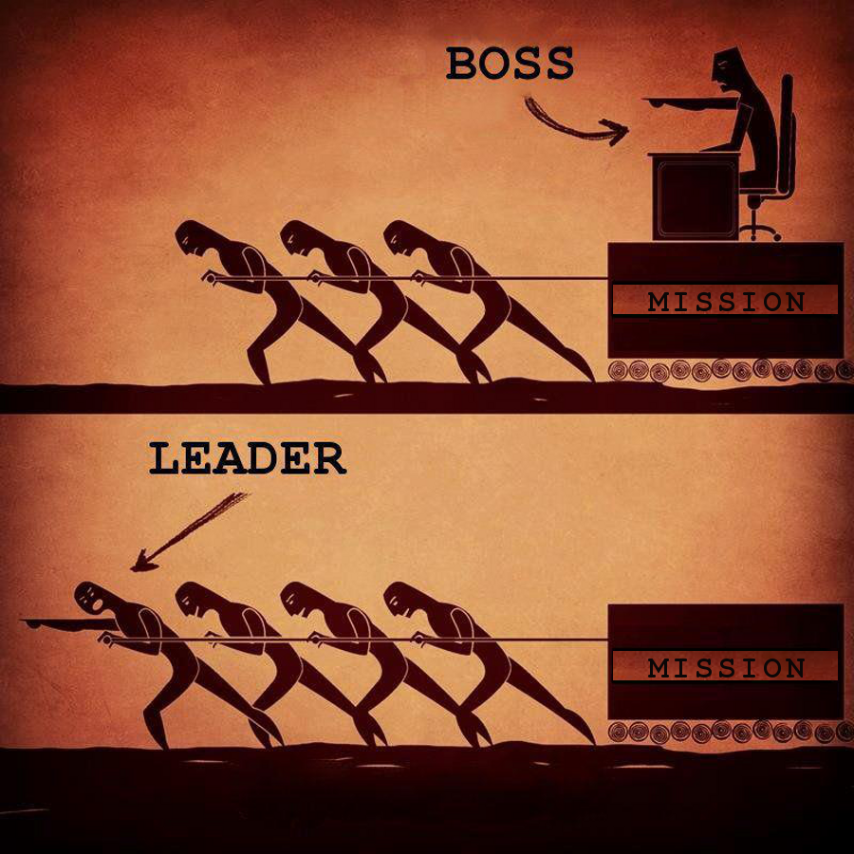

Slide 24
Boss vs Leader
Boss
Leader
Drives employees
Depends on authority
Inspires fear
Says, “I”
Places blame for the breakdown
Knows how it is done
Uses people
Takes credit
Commands
Say, “Go”
Coaches them
On goodwill
Generates enthusiasm
Says, “We”
Fixes the breakdowns
Shows how it is done
Develops people
Gives credit
Asks
Says, “Let’s go”

Slide 25
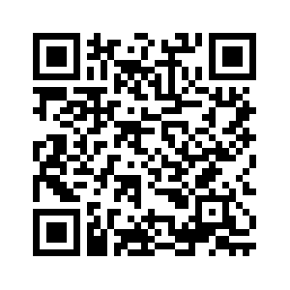
Thank You
chadgreen@chadgreen.com
TaleLearnCode
ChadGreen.com
ChadGreen & TaleLearnCode
ChadwickEGreen

